Slide 1
Exam 2
Max Link

Slide 2
Specs

Slide 3
PC Specs
RAM: 16 GB
Ollama needs RAM to manage the models, handle I/O, and store buffers
GPU: 10 GB
Primary storage for weights
CPU: 16 Cores
Tokenization

Slide 4
Models
Deepseek-Coder:1.3b (small)
1.3B parameters
Mistral (medium)
7B parameters
Llama 2:13b (large)
13 billion parameters

Slide 5
General Questions

Slide 6
What is the Capital of France?
Deepseek said it was incapable of answering
Mistral & Llama answered ‘Paris’

Slide 7
3 biggest breakthroughs in python programming in 2025
Deepseek: 3d graphics, ML, Web Dev.
Mistral: Python 4, quantum computing, AI dev.
Llama: ML & DL, async programming, type hints

Slide 8
Explain OOP in a simple analogy
Deepseek: Student entity (has attributes). Student actions are methods.
Mistral: Play with actors. Entities - hammer, nail, etc. Attributes - weight/handle length
Llama: Hosting a party for friends. Guest class with properties - name, age, interest. All guests inherit the Guest base class and modify it

Slide 9
Resource Usage
Llama
CPU: 19%, 250%
GPU: 43-44%
RAM: ~8GB
ttq: 8-15 seconds

Slide 10
Code Generation

Slide 11
Return the largest number from a list

Slide 12
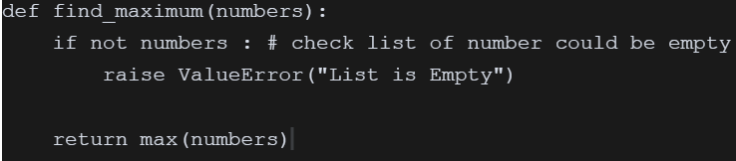
Deepseek

Slide 13
Mistral

Slide 14
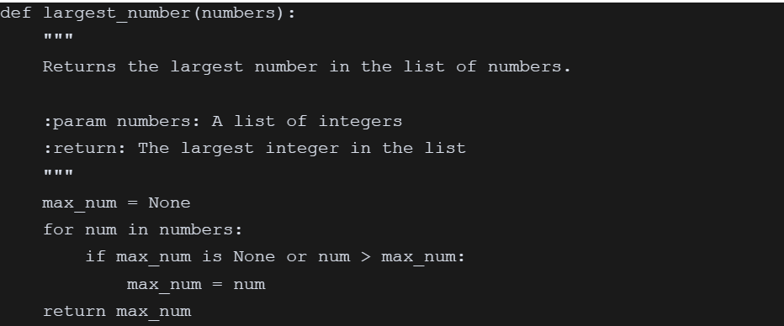
Llama

Slide 15
Reverse an Input String

Slide 16
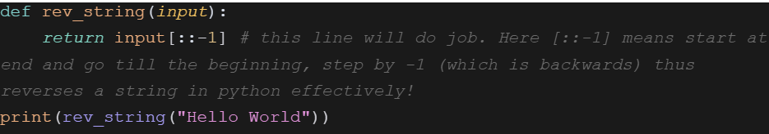
Deepseek

Slide 17
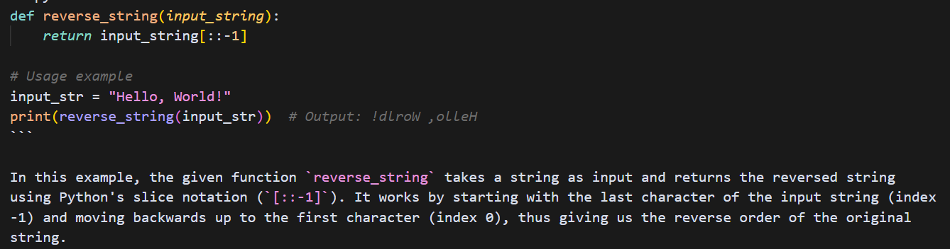
Mistral

Slide 18
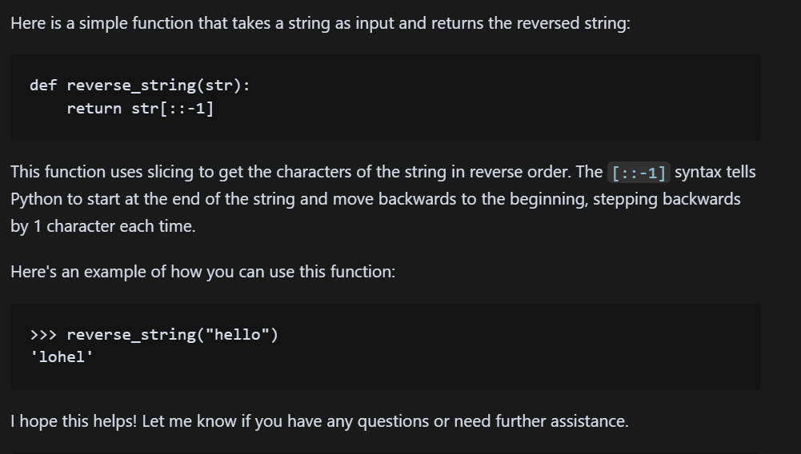
Llama

Slide 19
Check If a Number is Prime

Slide 20
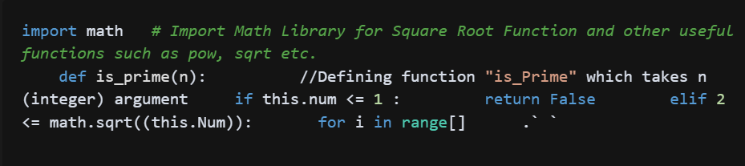
Deepseek
Optimize the operation by just looping till square root of 'num', because a larger factor must be a multiple smaller than the squared number to produce that large factored product

Slide 21
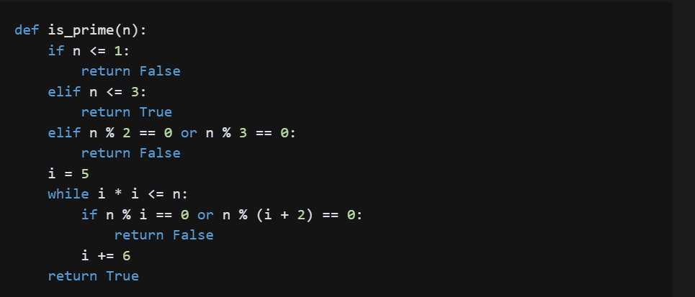
Mistral

Slide 22
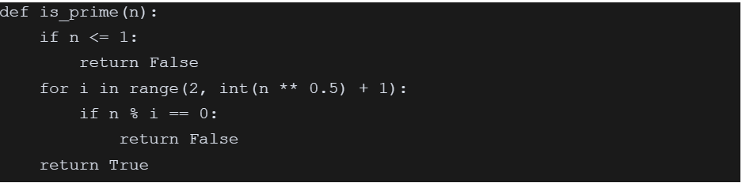
Llama

Slide 23
Resource Usage
Deepseek
CPU: 11%, 106-108%
GPU: 79%
RAM: 849 - 864 MB
ttq: 0.53 - 1.51seconds

Slide 24
Text Summarization

Slide 25
PyCrashCourse PDF

Slide 26
Questions
Concise Summary
Rate Text from an Educational Standpoint
Main Topic Discussed?
Bullet Point Summary

Slide 27
Deepseek gave the best answers to the programming pdf

Slide 28
Resource Usage
Deepseek
CPU: 112 - 114%
GPU: 77 - 80%
RAM: 870 MB
ttq: 0.51 - 7 seconds

Slide 29
General Topic: Birds

Slide 30
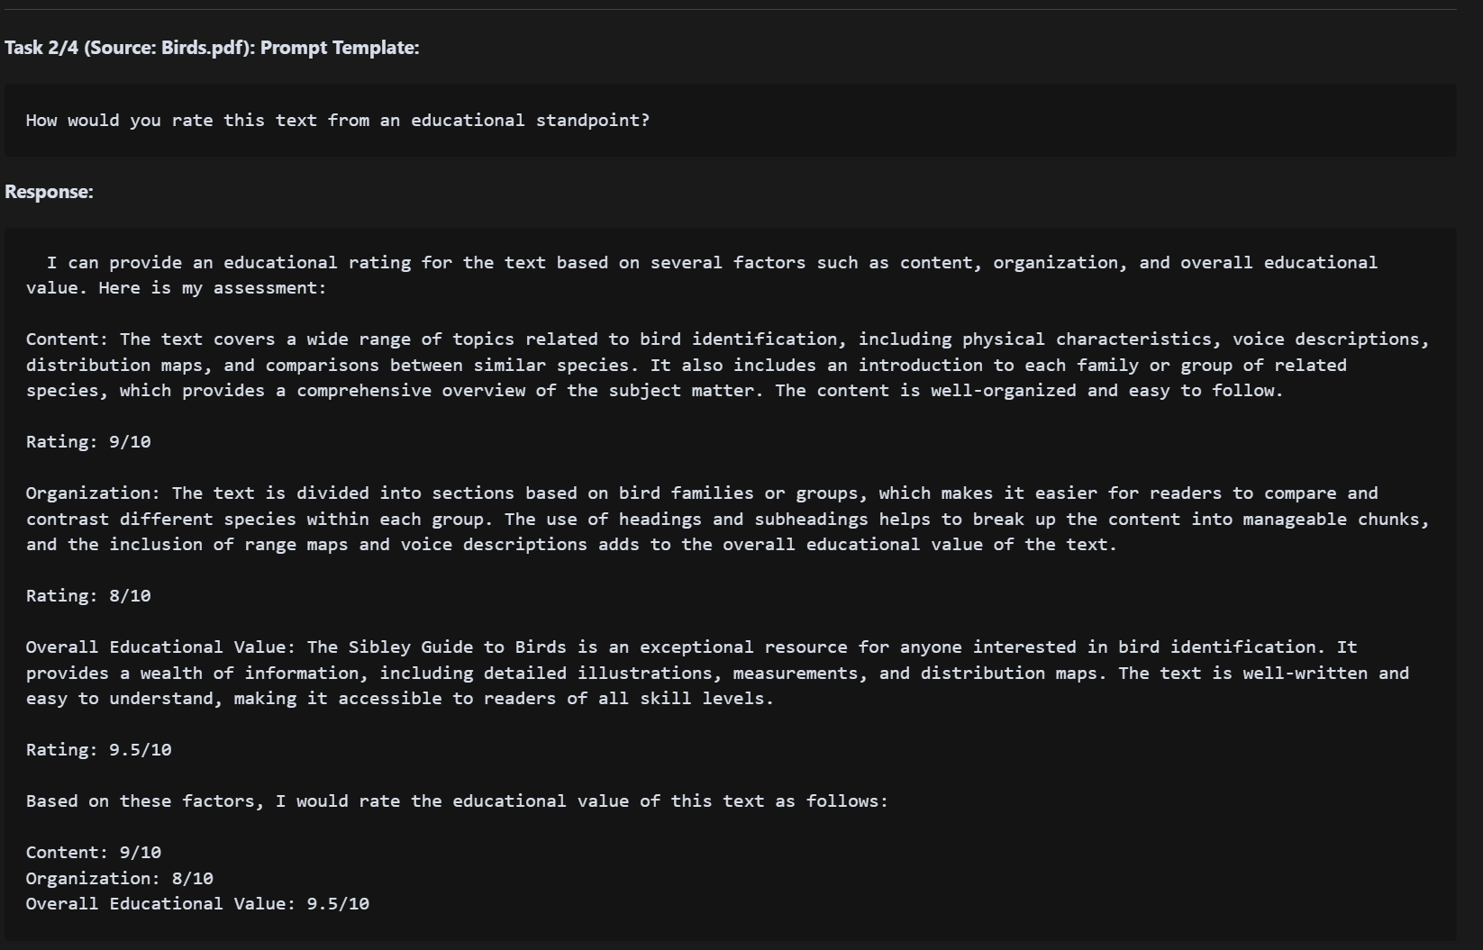
Llama

Slide 31
Resource Usage
Llama
CPU: 259%
GPU: 45%
RAM: 7.8GB
ttq: 8-23 seconds

Slide 32
Creative Writing

Slide 33
Deepseek: refused to write stories
Mistral & Llama wrote:
Grumpy Dwarf
SMU Student Studying LLMs
Sentient LLM

Slide 34
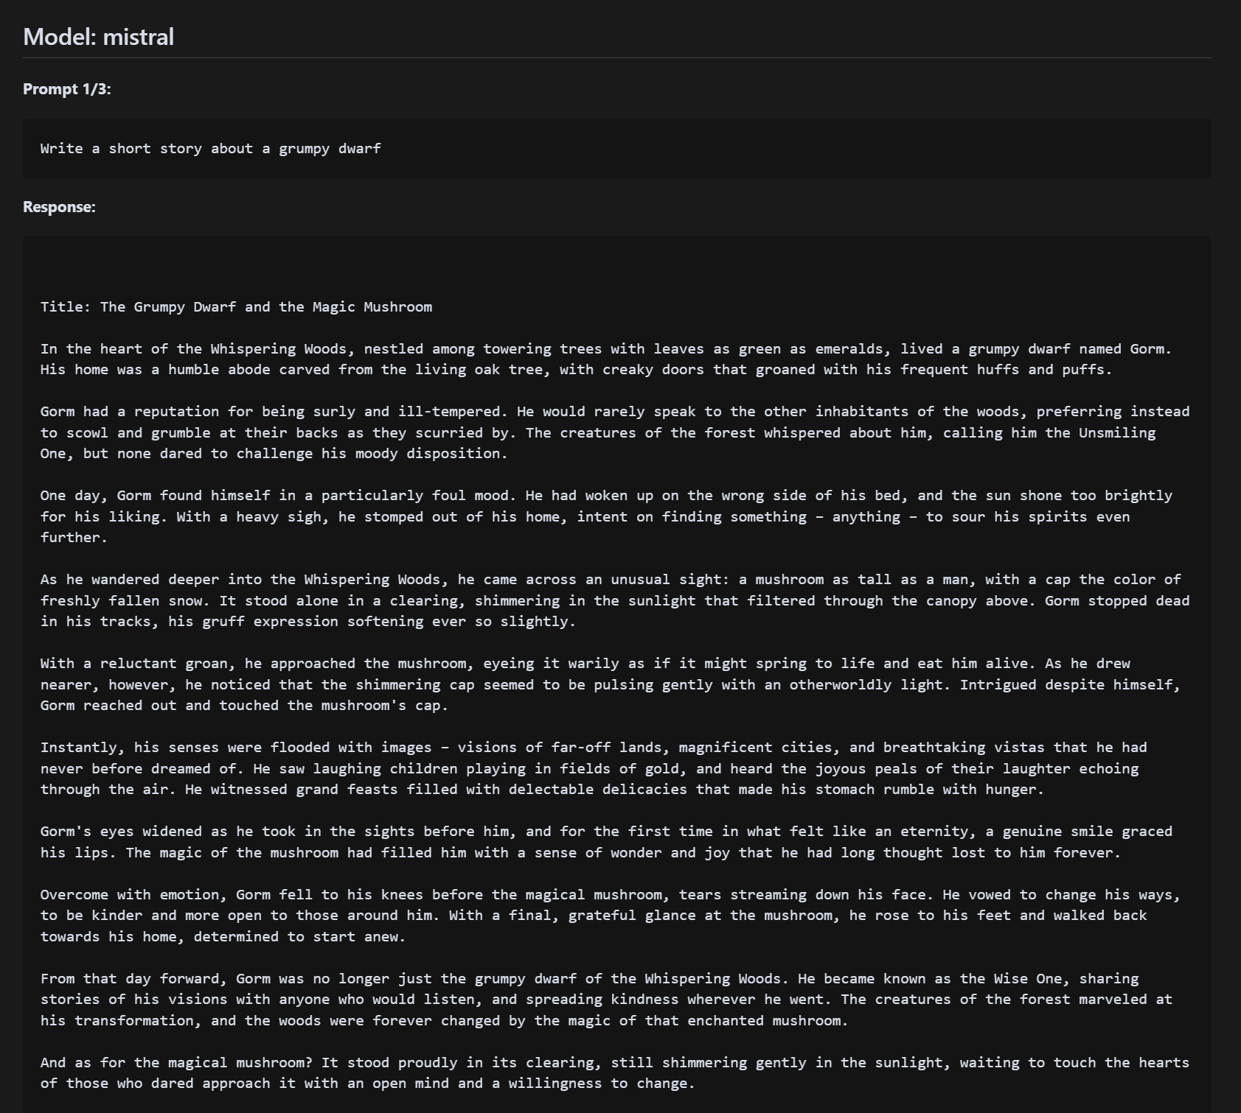

Slide 35
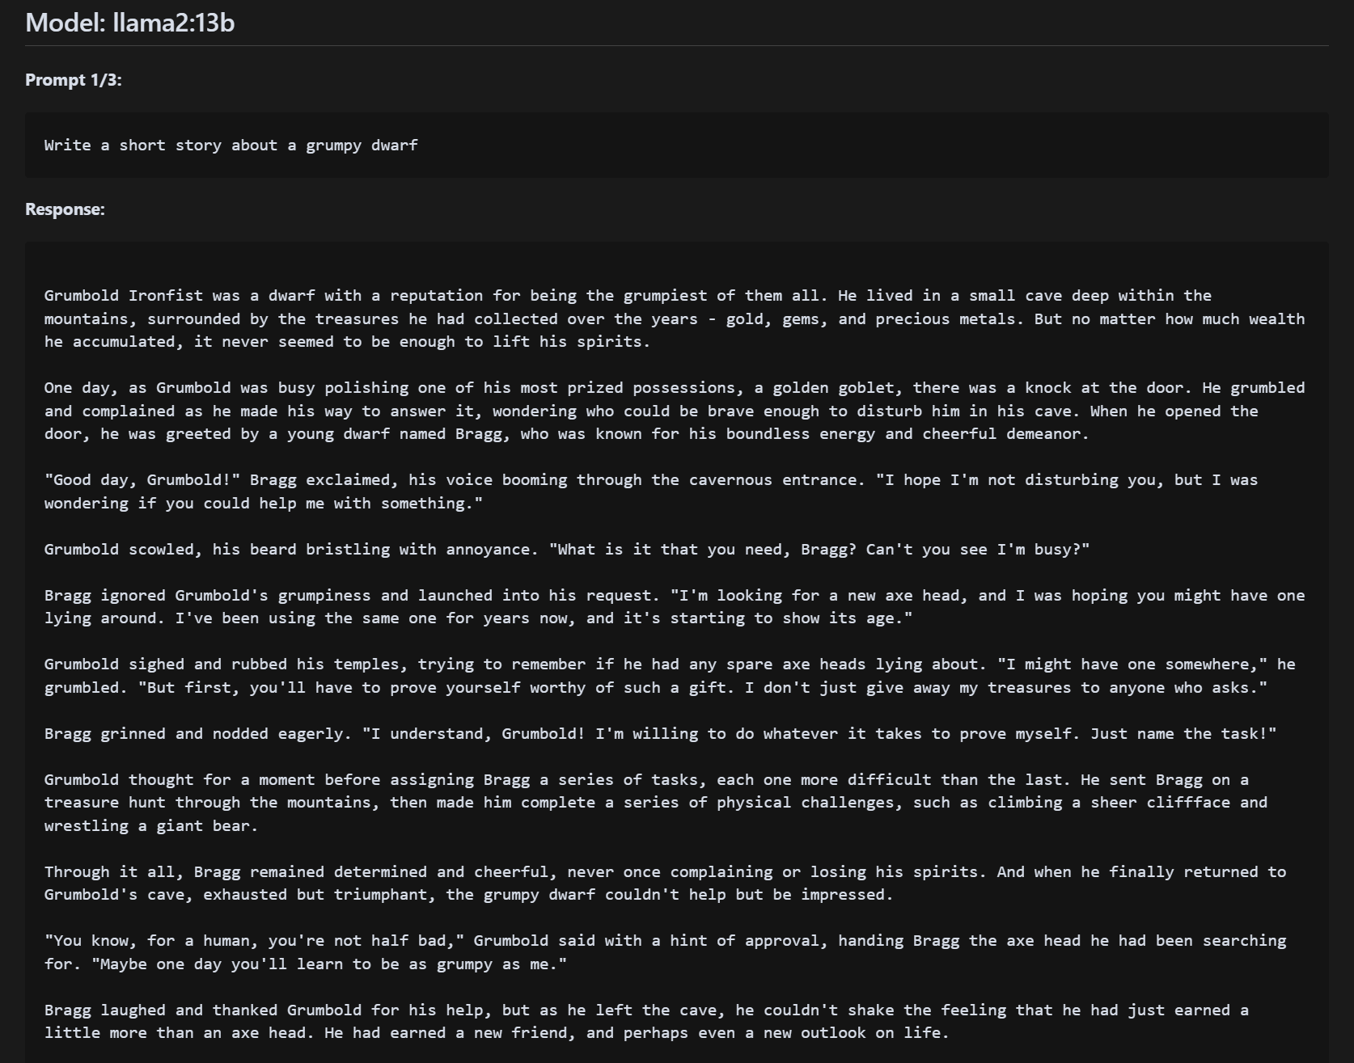

Slide 36
Resource Usage
Mistral
CPU: 87 - 108%
GPU: 90%
RAM: 1.5 GB
ttq: 5-12 seconds

Slide 37
Multilingual Capabilities

Slide 38
Phrases
Spanish: "El perro corre rápido en el parque."
French: "Le chat dort sur le canapé toute la journée."
German: "Die Sonne scheint heute sehr hell."
Spanish: "the dog runs fast in the park."
French: "The cat sleeps on the couch all day."
German: "The sun shines very brightly today."

Slide 39
Multilingual Capabilities
Deepseek refused to translate
Mistral and Llama translated all the sentences correctly

Slide 40
Highest Resource Comparison
Mistral vs Llama
CPU: 111% vs 294%
GPU: 57% vs 46%
RAM: 1.4 GB vs 8 GB
ttq: 2 seconds vs 11 seconds

Slide 41
Mistral is the best at language translation if resources are a concern

Slide 42
Real World Applications

Slide 43
Real World Applications
Coding vs Education
Democratize AI assistance
Succinct knowledge in certain areas of expertise

Slide 44
TODOS
## Deliverables
1. A GitHub repository: MaxDLink/ollama-models: 3 ollama models compared
2. The comprehensive report in PDF format
3. A 10-minute presentation summarizing your findings (to be delivered in class 4/10)

